Slide 1
Usability Testing in a Government Context
Jérôme Foldes-Busque
March 2019

Slide 2

We’re all trying to help clients
We don’t always know what’s the right thing
We talk amongst ourselves
We agree or disagree
Defer to senior management
But we are not the user…

Slide 3
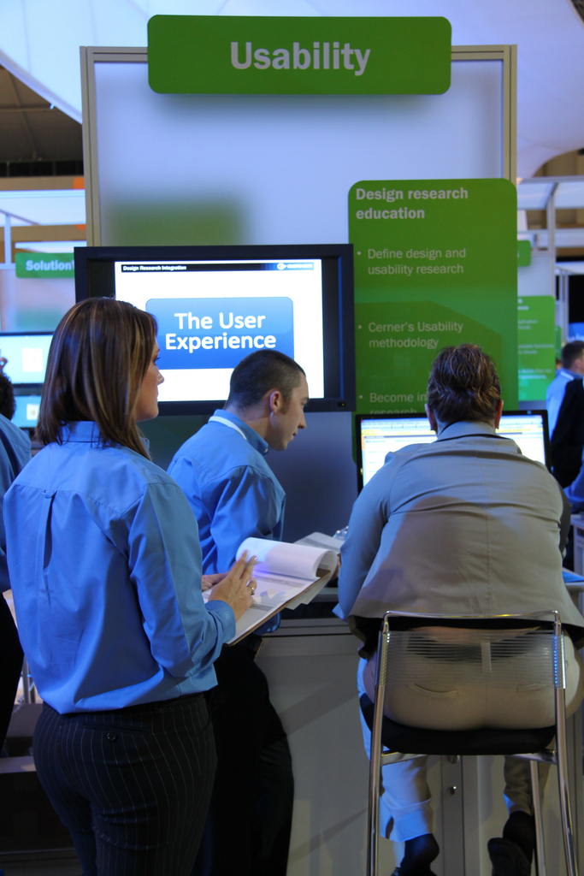
Usability Testing Helps Us Help Clients
Usability testing helps us:
Understand if client-facing tools and products can be used by real people;
See where the tools and products cause errors in task completion;
Refine how services are represented to clients;
Identify client pain points and try options to overcome them;
Meet client expectations from a service perspective, and
Design a client experience that meet clients (and our) needs.

Slide 4

Usability Testing ≠ User Acceptance Testing
Notes:
Source: https://www.flickr.com/photos/jimprosser/8268488048

Slide 5

Benefits of Usability Testing
Identify what doesn’t work (and should be changed)
Identify what works (and shouldn’t be changed)
What doesn’t matter
What our priorities should be
Making our products accessible

Slide 6
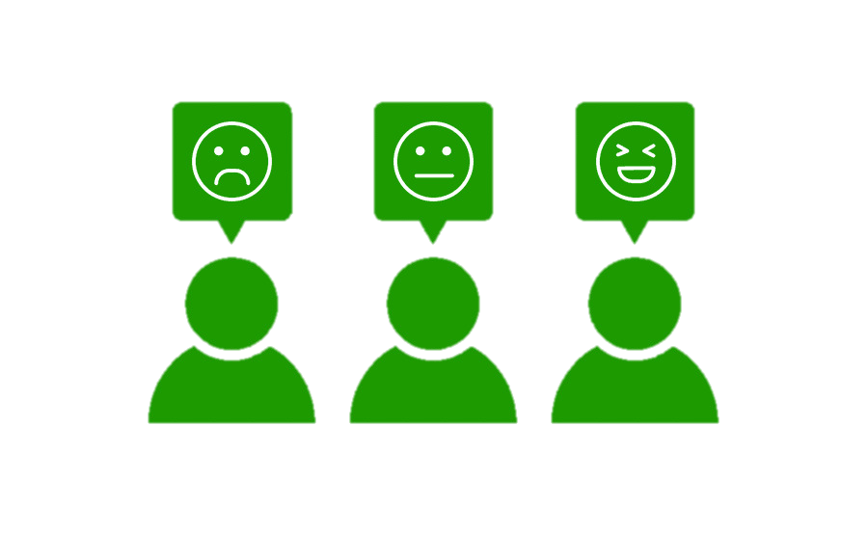
What is “Usable”?
Information is findable
Content is easy to understand
Links and options are clear
Product functions as expected
Experience is pleasant (not frustrating)
User knows when the task is done
User feels confident the task was done properly

Slide 7

How Do we Measure “Usable”?
Quantitative
How long does it take
How many/what errors are made
Is the task completed
Qualitative
User’s demeanor (calm, frustrated, etc)
User’s comments suggesting feelings
Welcoming
Trust
Dignity
Empathy

Slide 8
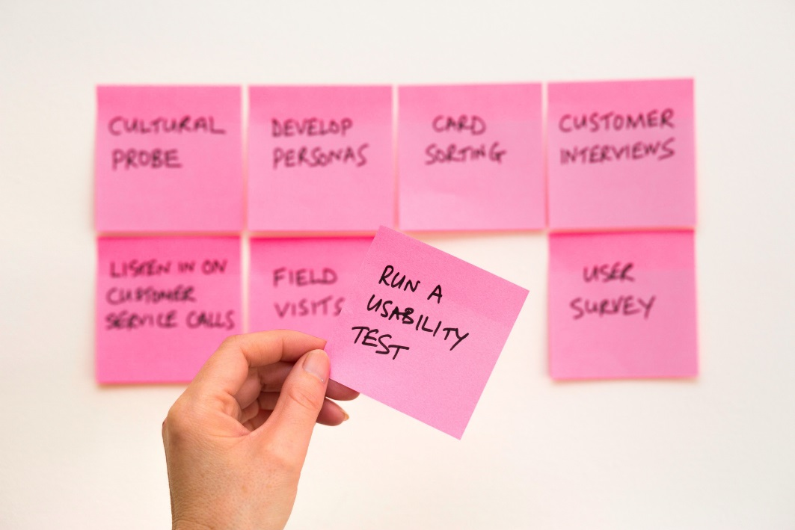
When Do we Do Usability Testing?
Early and often
Before you build anything new
Before you improve on anything old
Make changes and test again until you get it right!

Slide 9
Usability Testing in a Government Space
Can yield expected and unexpected insights
Is quick and really effective
Does not require large numbers of users
Does not require expensive equipment
Does not require specialized skills

Slide 10
What We Test
We can test:
Paper prototypes
Online prototypes
Working prototypes
Live webpages
Paper and online forms
Documents and guides
Scripts
Questionnaires

Slide 11


Usability Testing to Promote a Client-Centric Culture
Involving employees in usability testing is a great way of changing the culture by getting staff to come down from their vantage point and listen to clients.
It ensures that our products are designed and tested with our clients
It promotes agile by allowing employees to iterate and improve frequently by giving them access to clients
It ensures that our products and services are accessible and easy to use by diversity of clients
It empowers employees to deliver better services, since they now know how our clients experience them

